Slide 1
Growing In Stature
What We Leave Behind
Adrian Liew
11/02/2018

Slide 2
What is Legacy?
Legacy
“Anything handed down from the past, as from an ancestor or predecessor”
You’re never too young to start thinking about legacy
You’re never too old to stop thinking about it

Slide 3
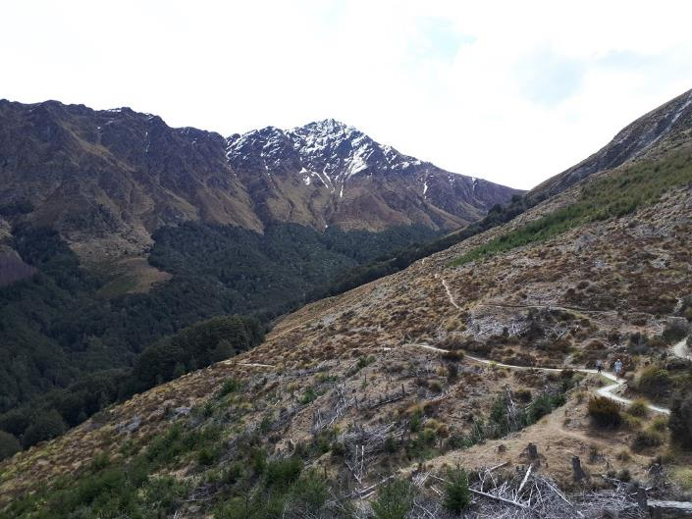
A Journey to The Top
Ben Lomond: Quick Stats
- Located about 4 km from Queenstown
- One of the highest peaks in the region
Height of 5,735 feet
Travel time up and down: 6-8 Hours

Slide 4
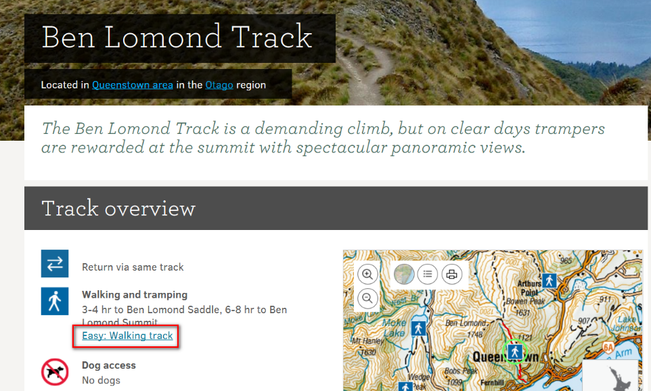
A Journey to The Top

Slide 5
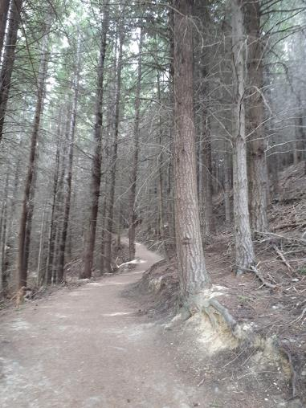
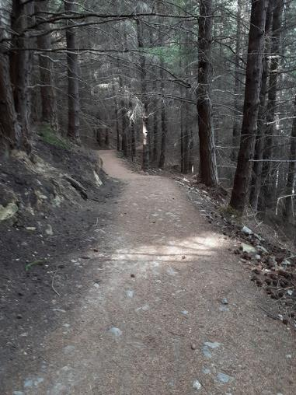
A Journey to The Top

Slide 6
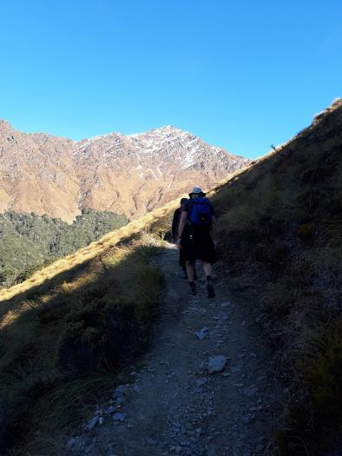
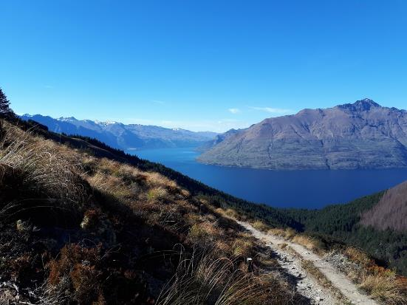
A Journey to The Top

Slide 7
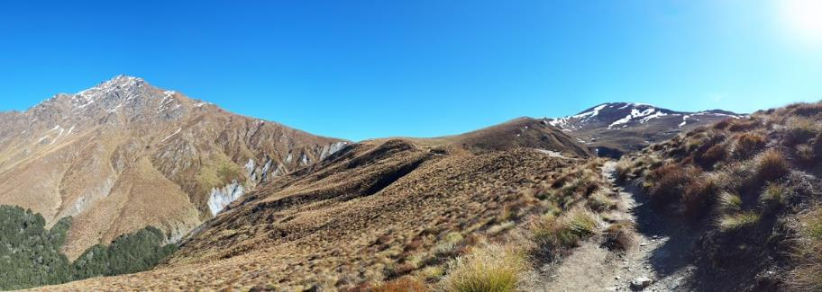
A Journey to The Top

Slide 8
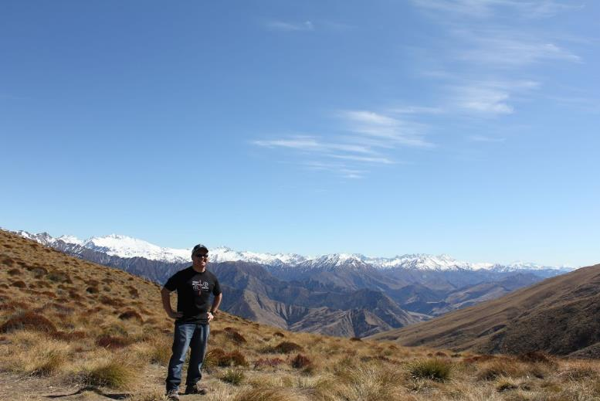
A Journey to The Top
The Saddle – Halfway There!

Slide 9
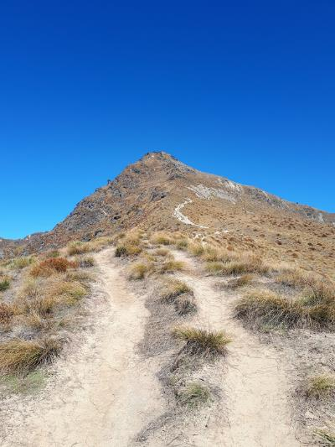
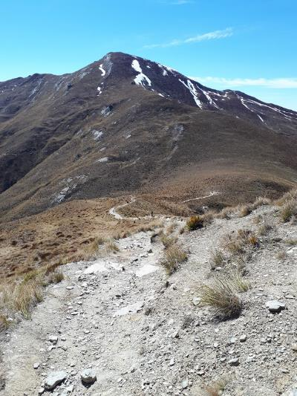
A Journey to The Top
The crowd begins to thin out…

Slide 10
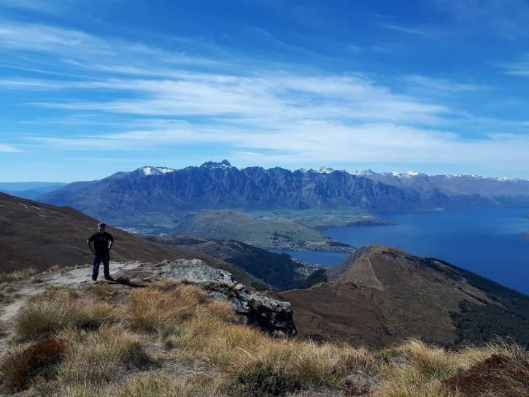
A Journey to The Top

Slide 11
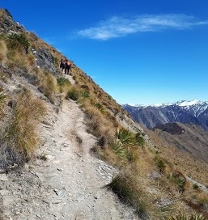
A Journey to The Top

Slide 12
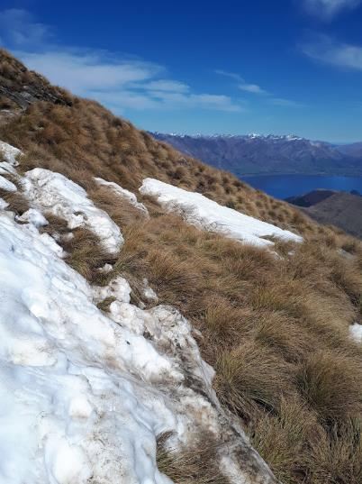
A Journey to The Top

Slide 13
What Does it Mean To Follow Christ
1) Count the Cost
Luke 14:25-33
25 Large crowds were traveling with Jesus, and turning to them he said: 26 “If anyone comes to me and does not hate father and mother, wife and children, brothers and sisters—yes, even their own life—such a person cannot be my disciple. 27 And whoever does not carry their cross and follow me cannot be my disciple.

Slide 14
What Does it Mean To Follow Christ
28 “Suppose one of you wants to build a tower. Won’t you first sit down and estimate the cost to see if you have enough money to complete it? 29 For if you lay the foundation and are not able to finish it, everyone who sees it will ridicule you, 30 saying, ‘This person began to build and wasn’t able to finish.’
31 “Or suppose a king is about to go to war against another king. Won’t he first sit down and consider whether he is able with ten thousand men to oppose the one coming against him with twenty thousand? 32 If he is not able, he will send a delegation while the other is still a long way off and will ask for terms of peace. 33 In the same way, those of you who do not give up everything you have cannot be my disciples.

Slide 15
What Does it Mean To Follow Christ
Are we prepared?
Going up higher reveals a lot about us
  Our attitudes and responses
  How we treat each other
The road is narrow - it’s not a casual stroll

Slide 16
What Does it Mean To Follow Christ
2) Faith = Action
James 2:17 -18
17 In the same way, faith by itself, if it is not accompanied by action, is dead.
18 But someone will say, “You have faith; I have deeds.” Show me your faith without deeds, and I will show you my faith by my deeds.

Slide 17
What Does it Mean To Follow Christ
2) Faith = Action
Going up the mountain doesn’t just happen, it requires action.
Do we take the prophetic word seriously?

Slide 18
What Does it Mean To Follow Christ
3) Our Journey is Our Legacy
Psalms 145:3-7
3 Great is the Lord and most worthy of praise;
his greatness no one can fathom.
4 One generation commends your works to another;
they tell of your mighty acts.

Slide 19
What Does it Mean To Follow Christ
5 They speak of the glorious splendor of your majesty—
and I will meditate on your wonderful works.
6 They tell of the power of your awesome works—
and I will proclaim your great deeds.
7 They celebrate your abundant goodness
and joyfully sing of your righteousness

Slide 20
What Does it Mean To Follow Christ
Inheritance is not just leaving possessions behind, but also Our Story(testimony)
Our life paves a way and sets a blueprint for others to follow
Whether we like it or not, people will follow our example
  Our attitudes and responses

Slide 21
What Does it Mean To Follow Christ
Keep giving God your best
put Him first and
Have a good attitude

Slide 22
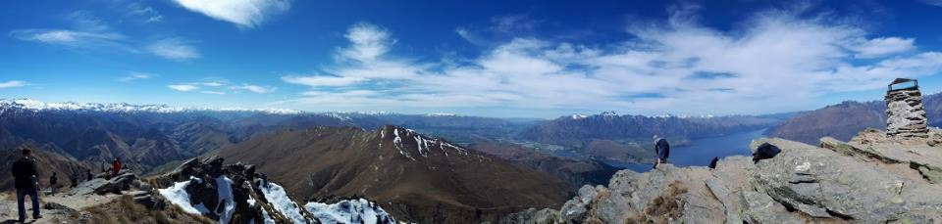
What did I see?

Slide 23
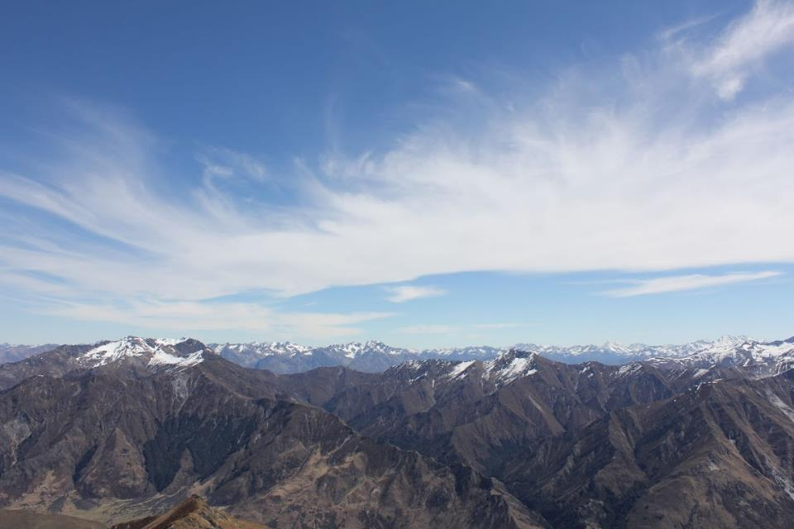
What did I see?

Slide 24
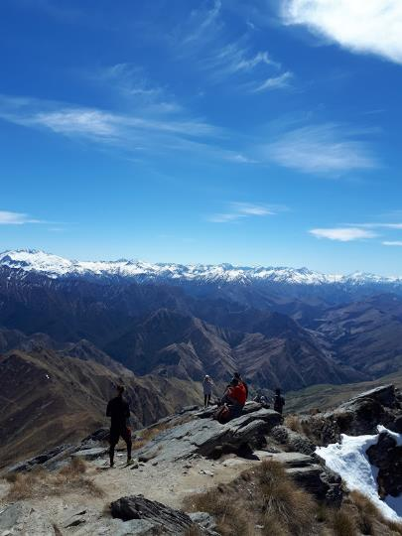
What did I see?

Slide 25
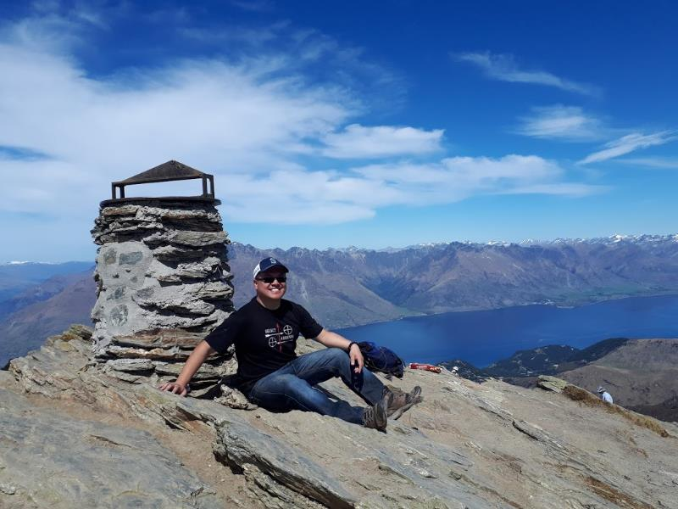
What did I see?

Slide 26
What Legacy Will You Leave?
Conclusion
I couldn't see exactly where the road was leading, but I knew where I needed to be
Learn to Count the Cost – There’s a Price to Pay for the view
The Journey Was Also The Reward

